Slide 1

Rooshi Patidar

Slide 2
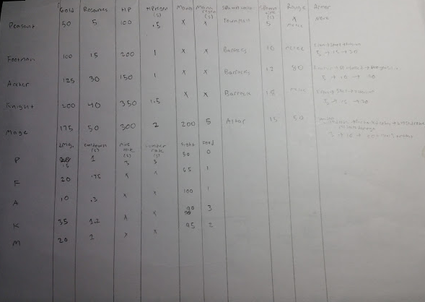
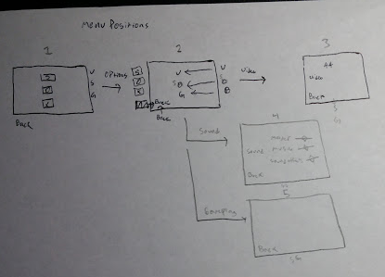
Development
Started with list of player classes and buildings in game
Made a table of classes and stats and diagrams of menus
Wanted an old style for textures and overall look
Worked on complicated features instead of finishing core gameplay

Slide 3
Class Layout
Actor Class
Peasant
Archer
Knight
Mage
Low Health/Damage
Can Mine and Build
High Speed
Ranged Attack
Low Speed
High Damage
Armor
Magic Damage
Healing
Ranged Attack
Building Class
Town Hall
Spawns Peasants
Barracks
Spawns Knights and Archer
Farm
Increased Amount of Food
Mine
Needed for Gold

Slide 4
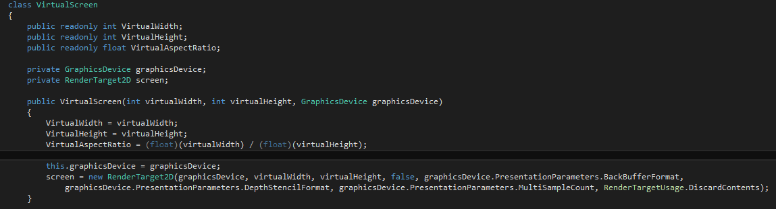
Teaching Topic: Render Targets
Class: RenderTarget2D
Acts like a Texture which you can draw to with a SpriteBatch
Draw Render Target back to screen
I used a class called VirtualScreen to contain the rendering methods

Slide 5
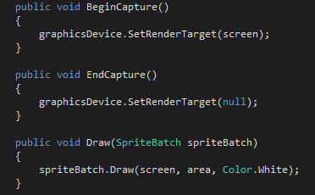
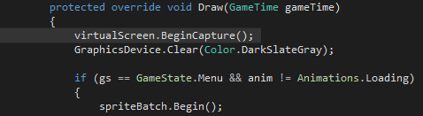

Render Target

